Slide 1

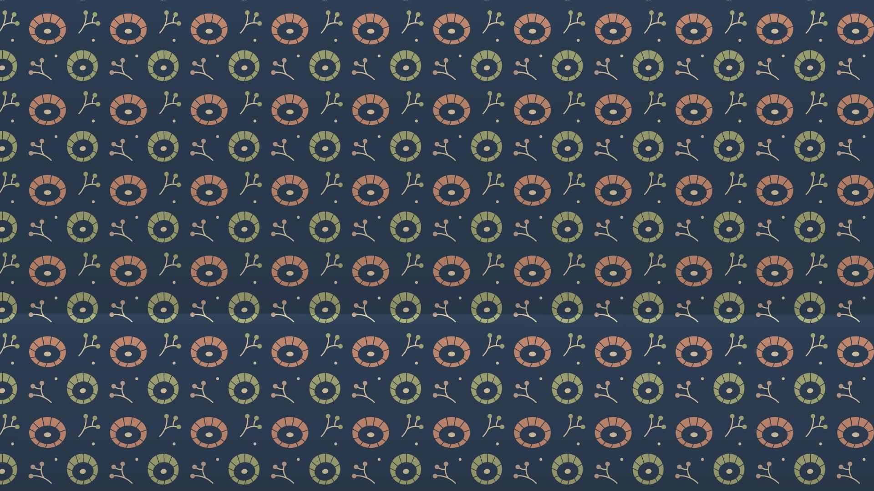
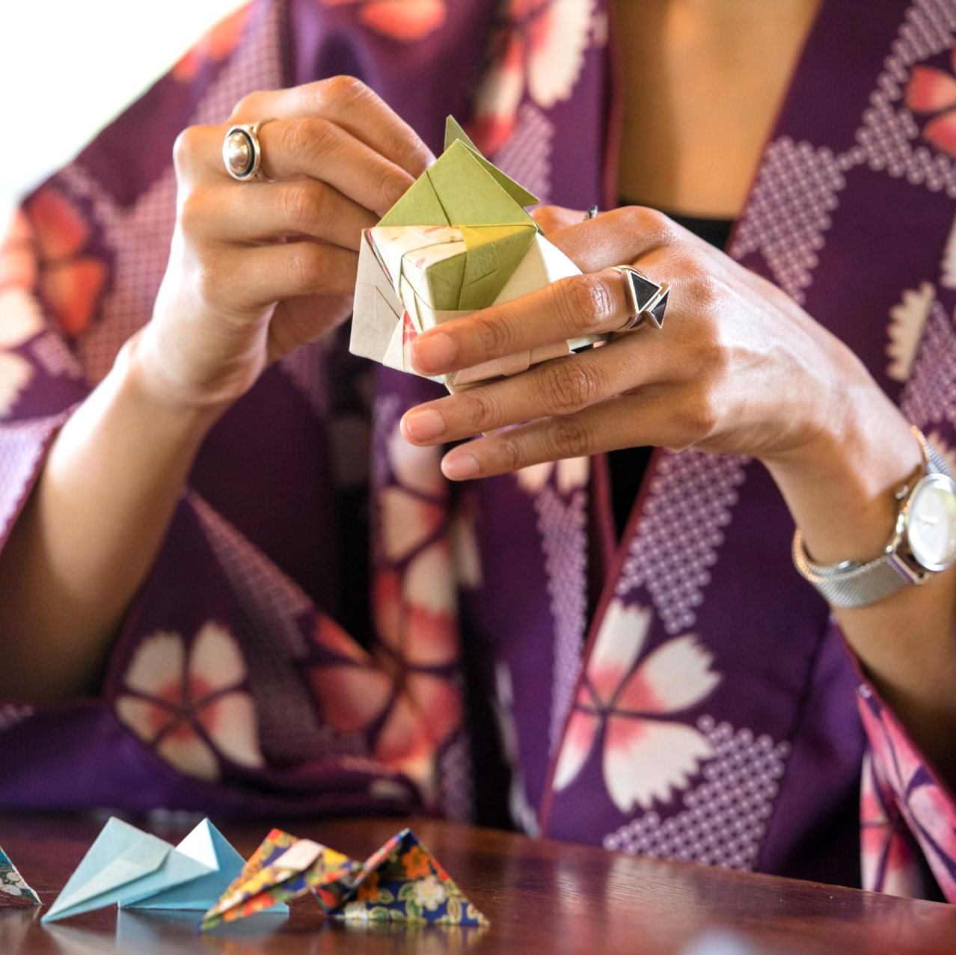

Origami-The Paper Folding Art

Slide 2
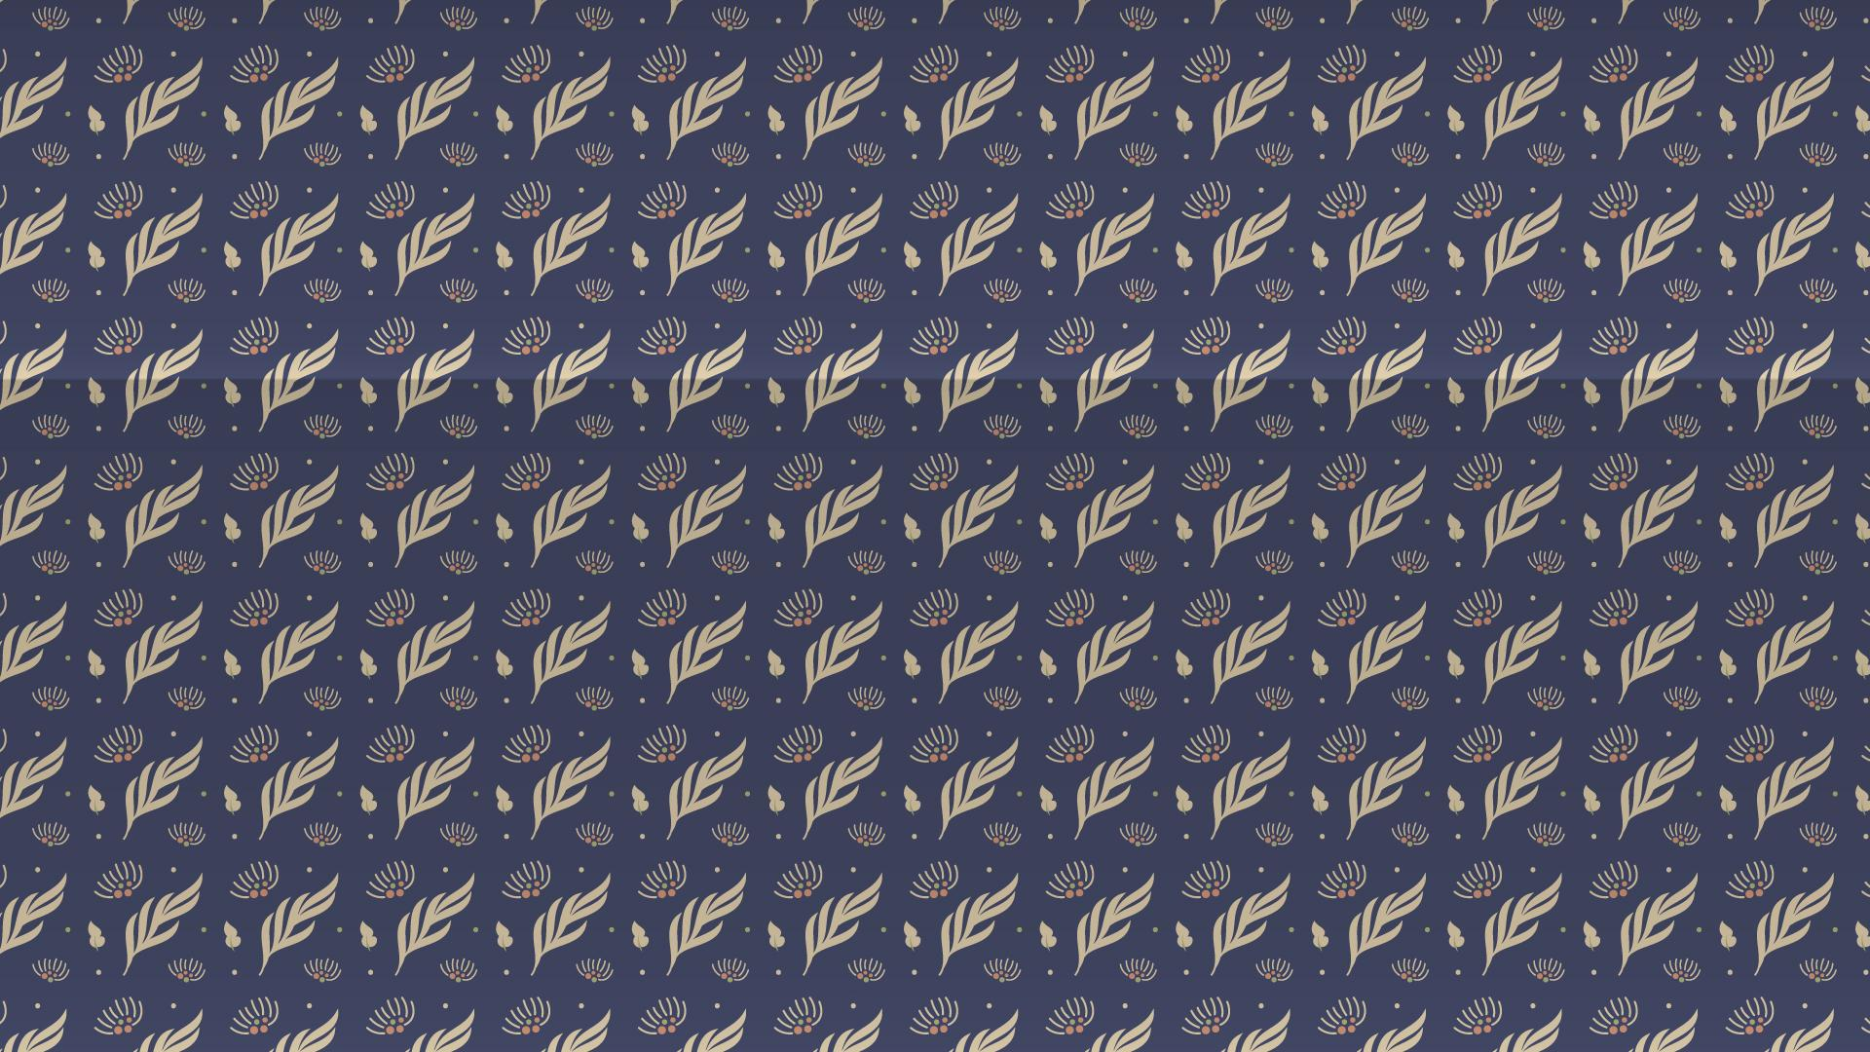

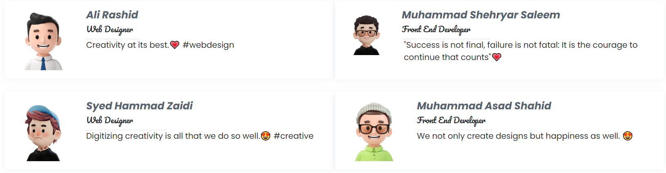
E-Project Team

Slide 3
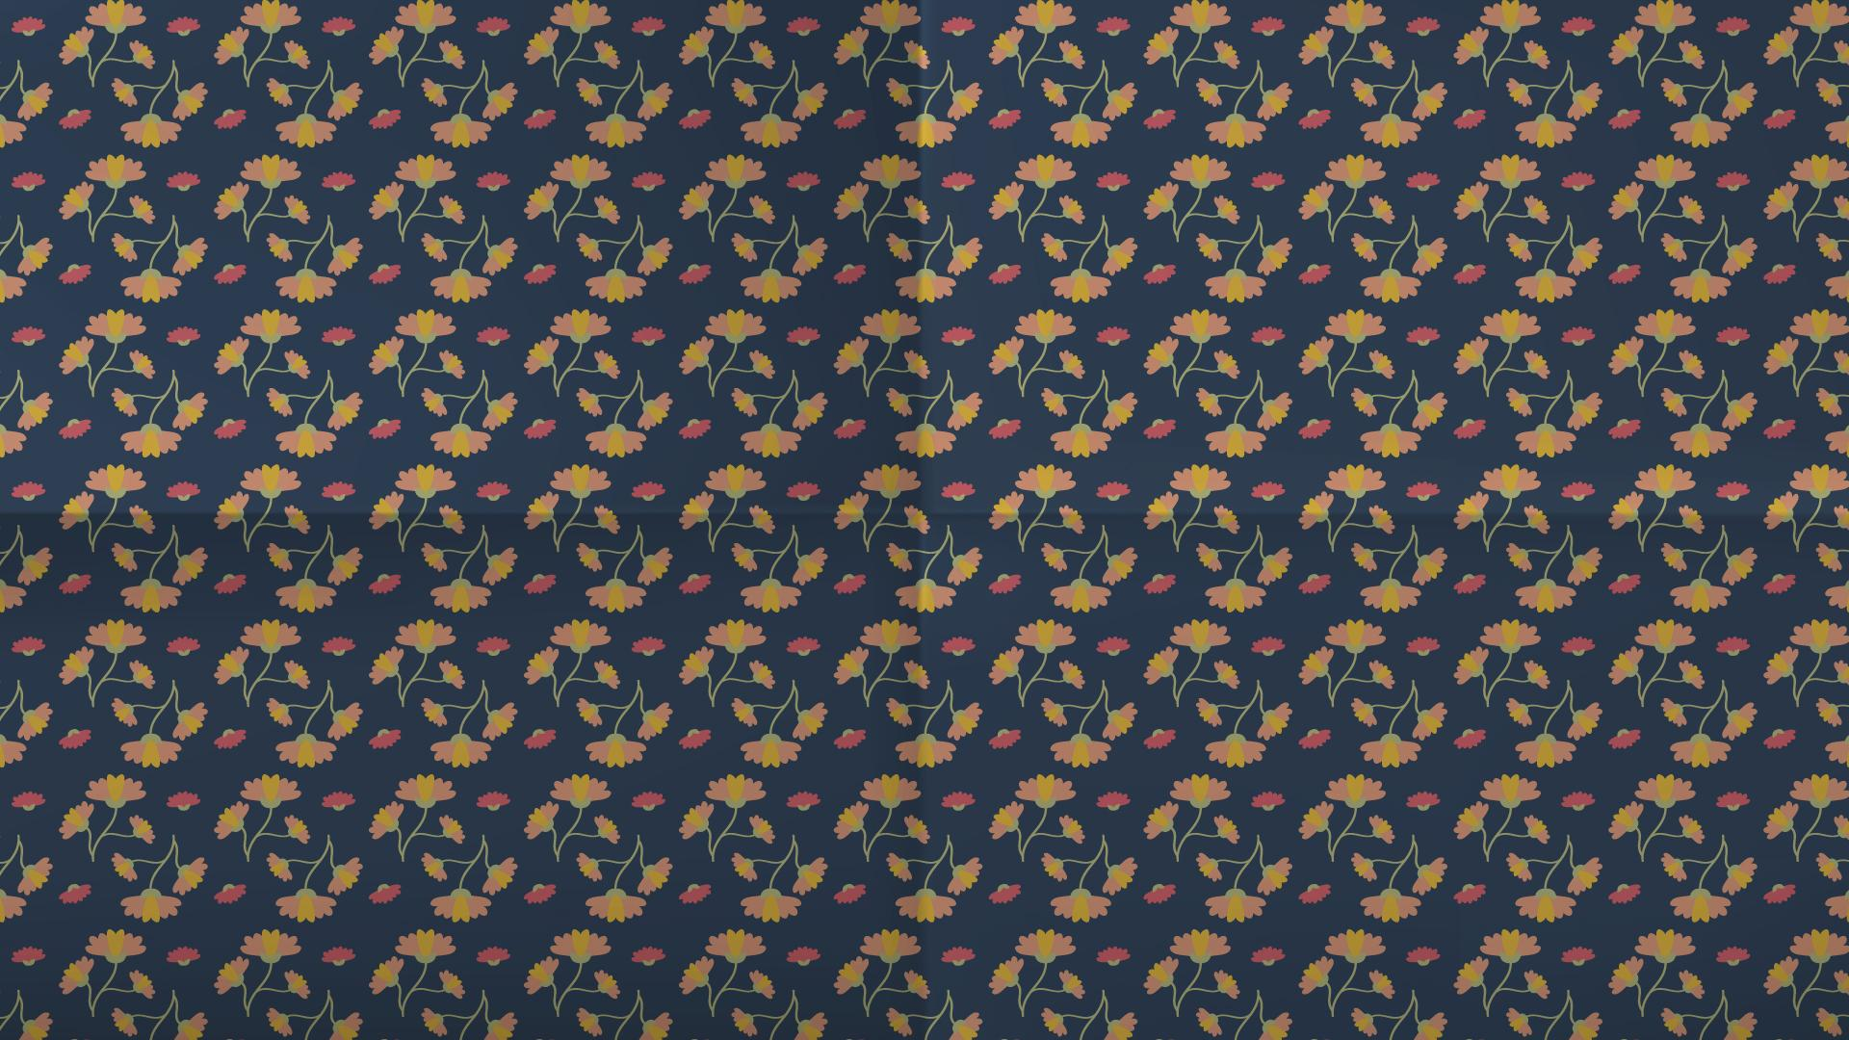
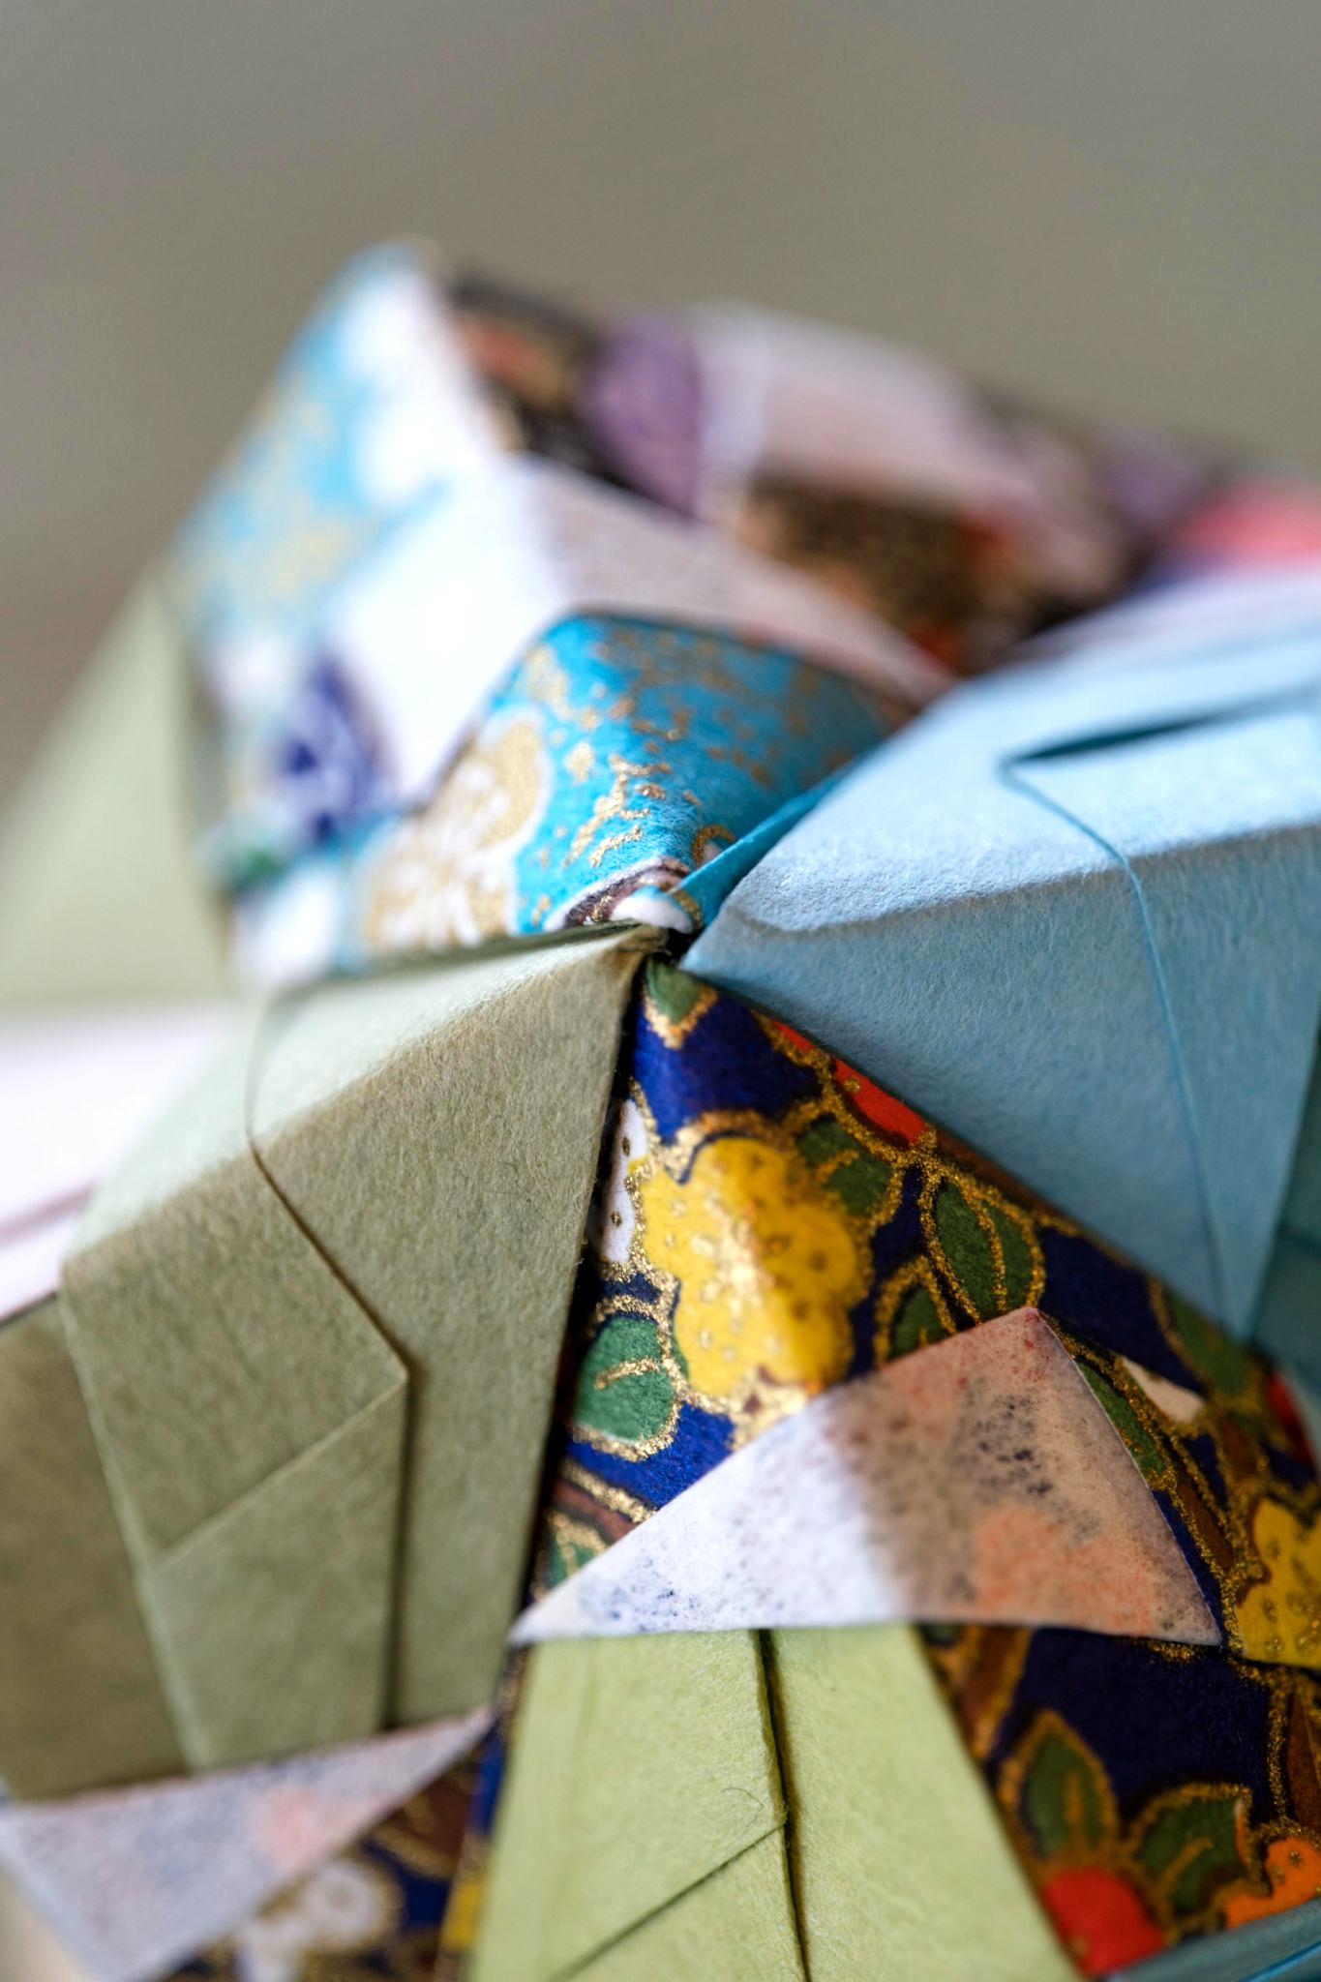

ORIGAMI
Origami is the Japanese art of paper folding.
"Ori" is the Japanese word for folding and "kami" is the Japanese word for paper.

Slide 4
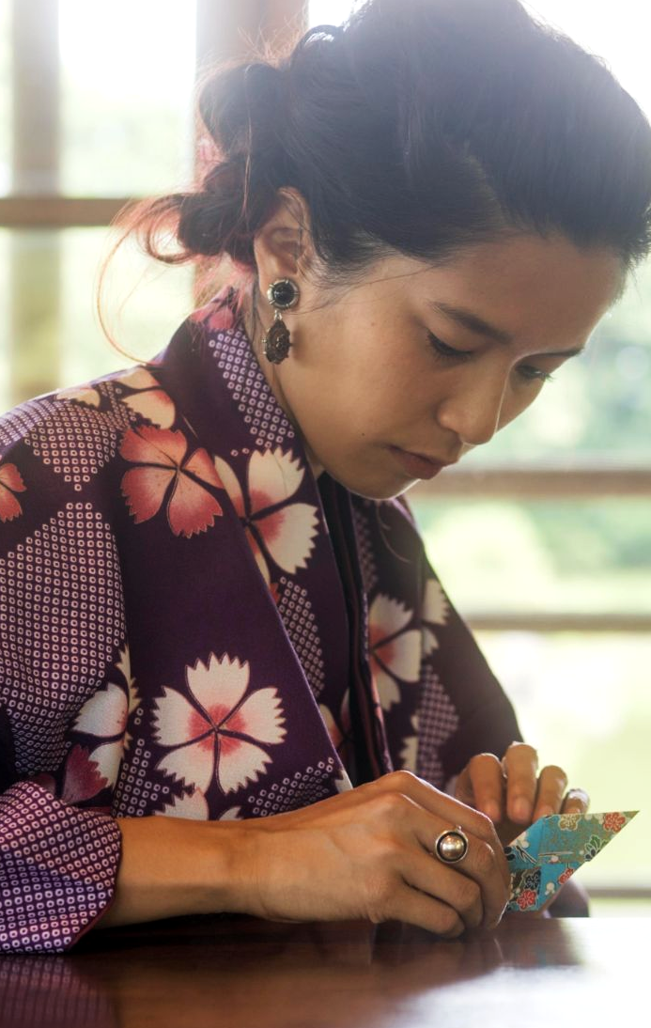
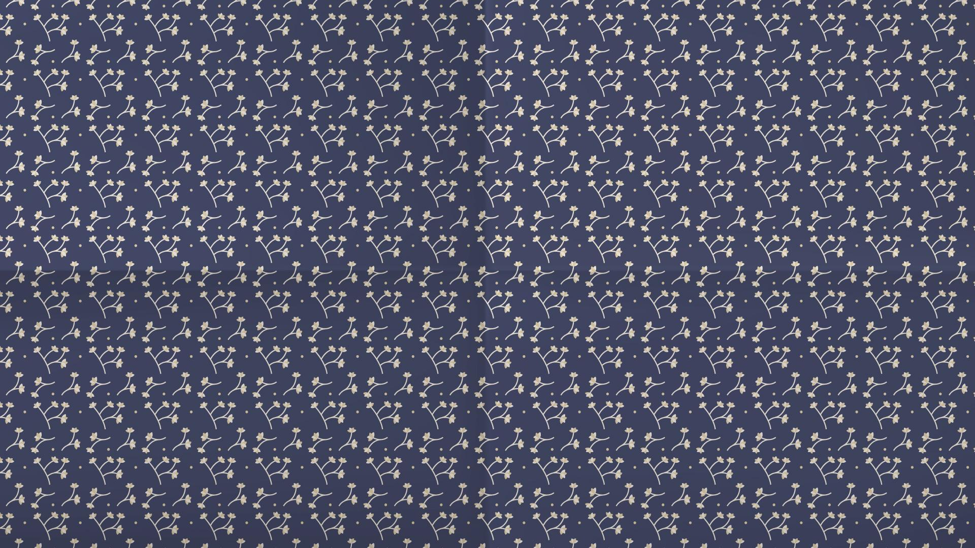
About Us
Origami originated from China and was popularized in Japan. It is the art of paper folding. Paper-folding is a wonderful hobby and a wonderful group activity... and for kids it has so many benefits socially and for the developing mind. You get to make cool stuff - with only a sheet of paper! It's incredible to watch an ordinary piece of paper transforming into a three dimensional form, and the more complex the design, the more incredible this process becomes...

Slide 5
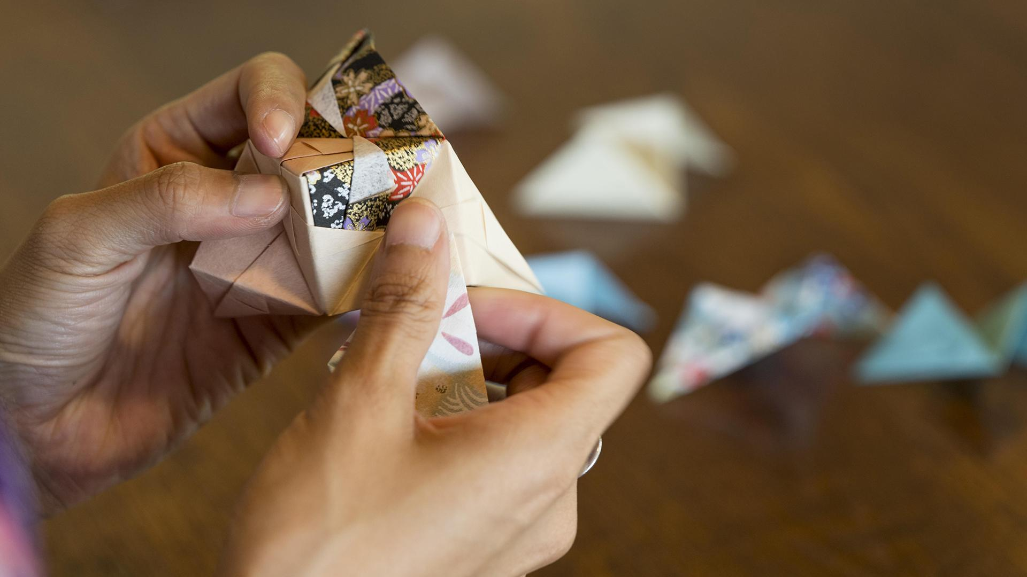


Creatives from several countries helped shape origami into the practice it is today

Slide 6
China
Paper was invented in China around 105 AD, and folded paper—or zhezhi—most likely emerged shortly after. By 900 AD, paper yuanbao, or gold nuggets, were a staple at traditional Chinese funerals.
Eventually, paper folding would become a common practice. Though similar to Japanese origami, more modern Chinese paper-folding exhibits an interest in representing inanimate objects, like boats and boxes

Slide 7
Japan
Paper was introduced to Japan in the 6th century. During this time, the practice of paper folding emerged as a ceremonial Shinto ritual. It was not until Japan's Edo Period (1603 – 1868) that origami would also be viewed as a leisurely activity and art form.
Like Japanese woodblock prints—an art form that also saw popularity during this time—origami works often featured flowers, birds, and other nature-based motifs.

Slide 8
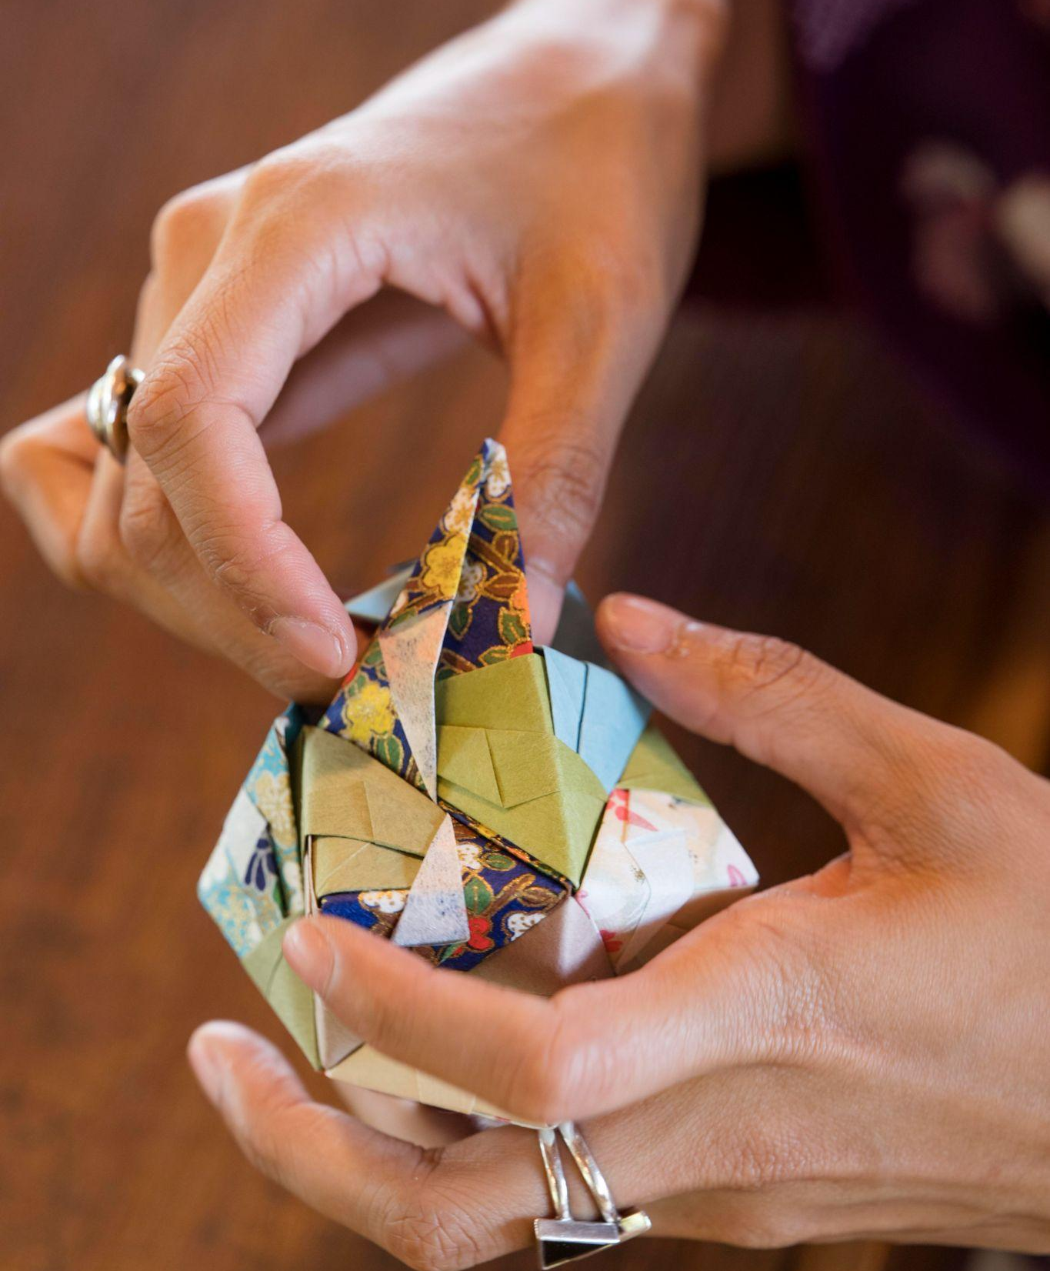
Instruction Origami For Kids

Slide 9
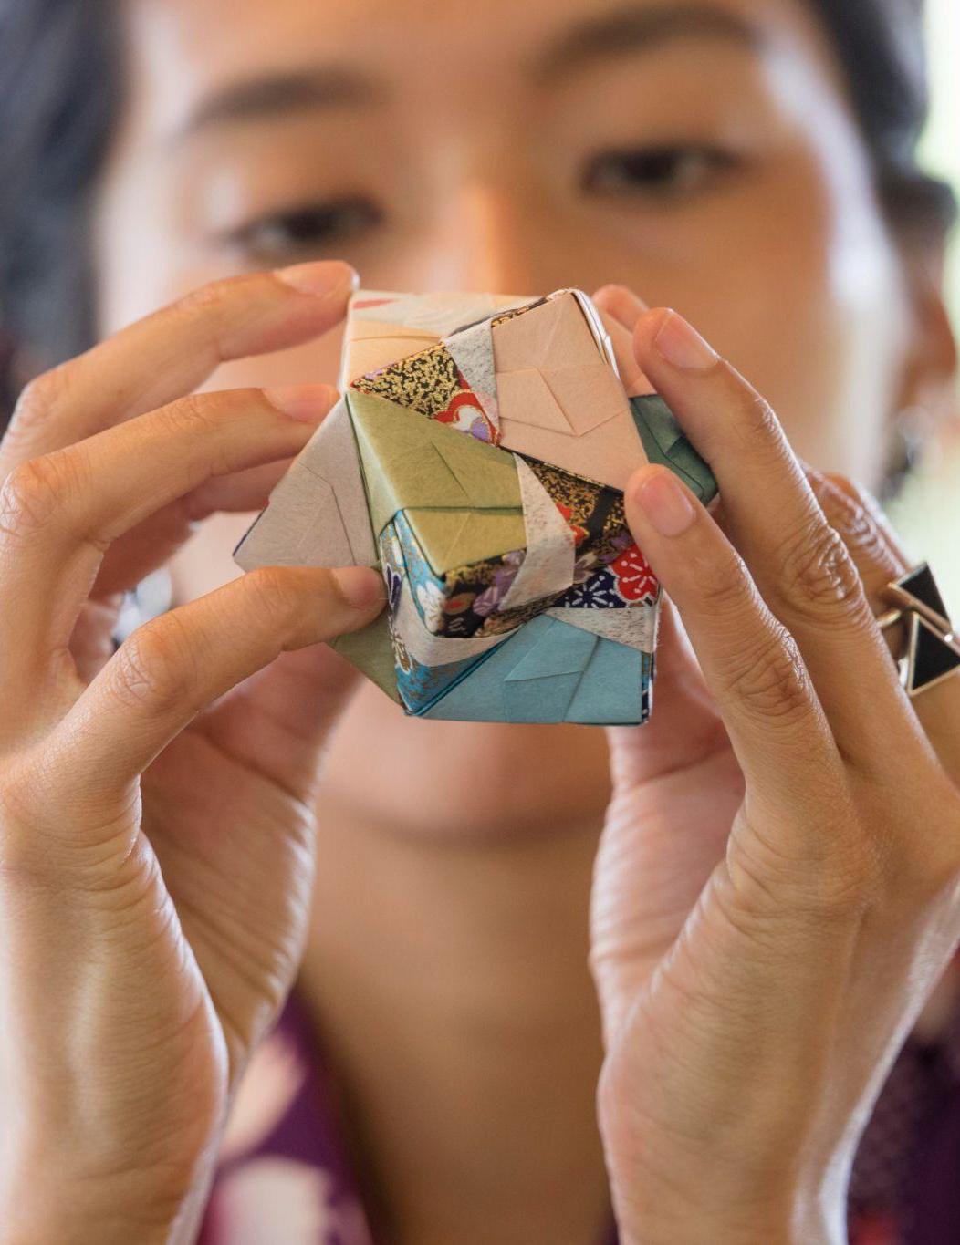
KID ORIGAMI
“These origami instructions for kids are fun and easy to make. Each of these origami models can be folded with children. Very young children may need a hand with some of the folds. All you need to make these easy origami models is a single sheet of paper. It doesn’t matter if you only have regular printer paper to work with.”

Slide 10
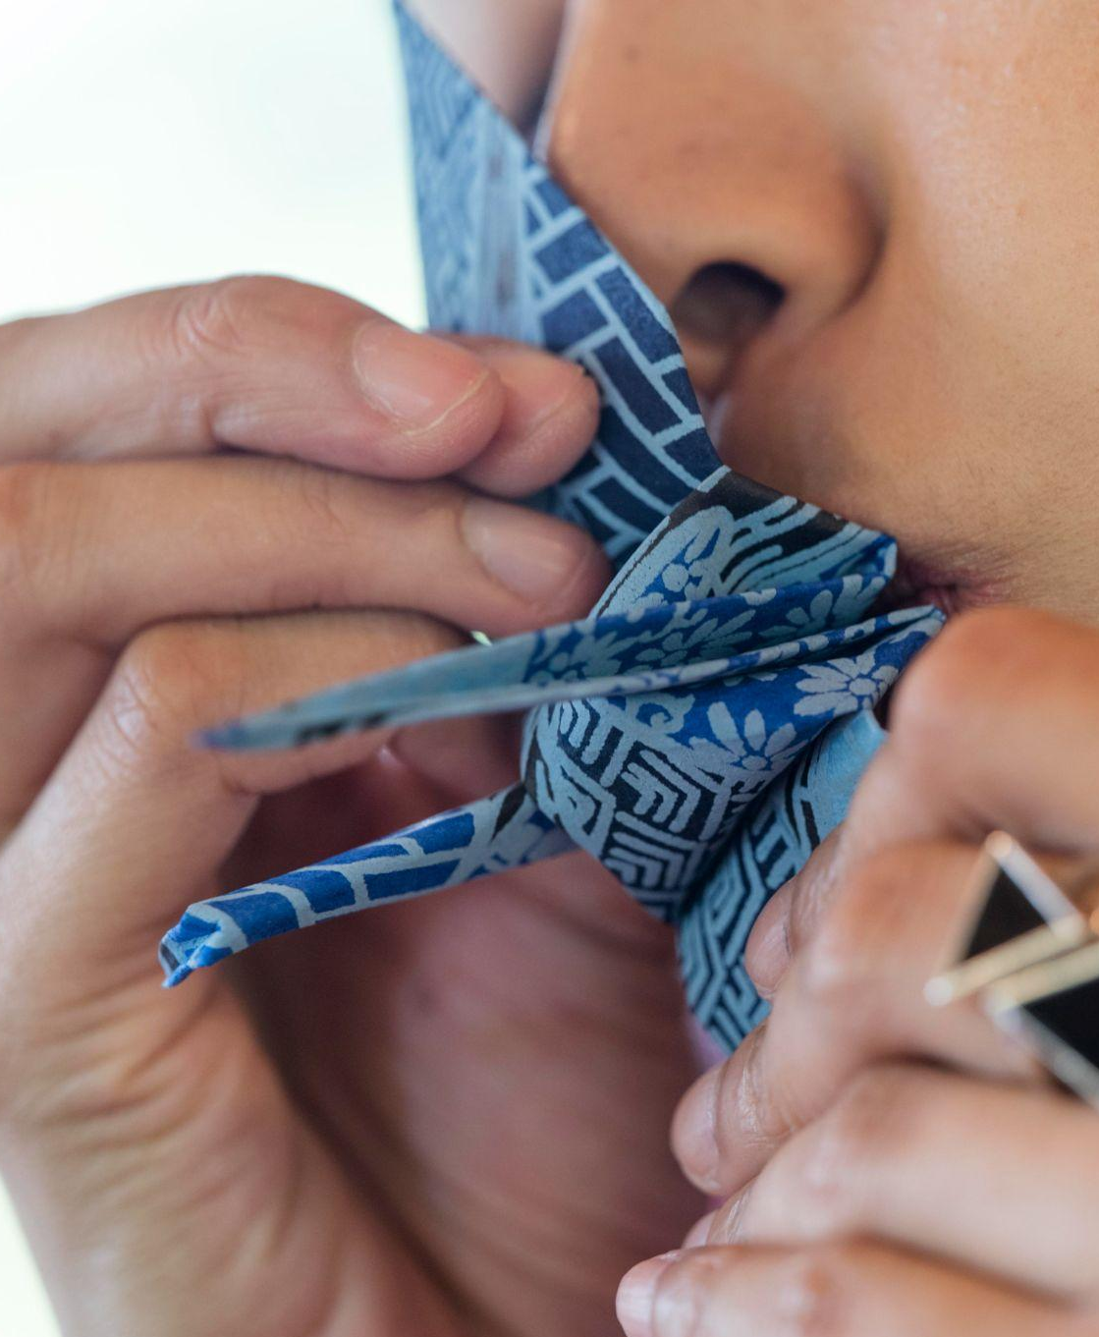
What I do
Mercury
Mercury is the closest planet to the Sun and the smallest one in the Solar System—it’s only a bit larger than the Moon
Venus
Venus has a beautiful name and is the second planet from the Sun. It’s hot and has a poisonous atmosphere

Slide 11
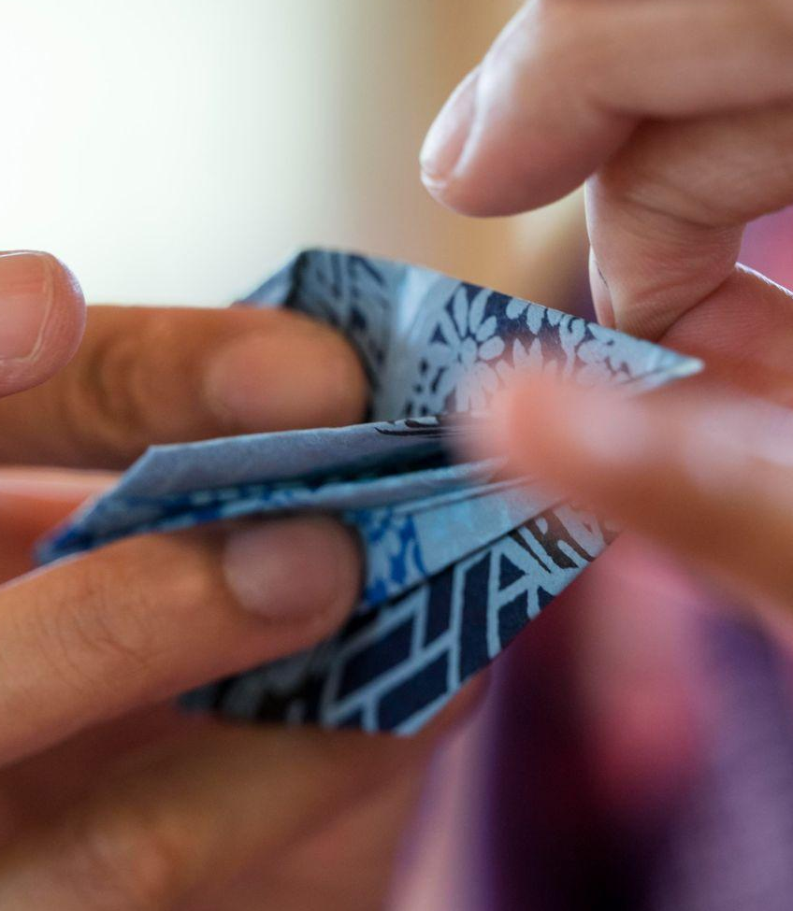
My resume
Education
Experience
2015 - 2019
2015 - 2019
Mention the institution List your studies here
Mention the company Describe your job here
2015 - 2019
Skills
Mention the company Describe your job here
Creativity
2015 - 2019
Att. to detail
Mention the company Describe your job here
Folding

Slide 12
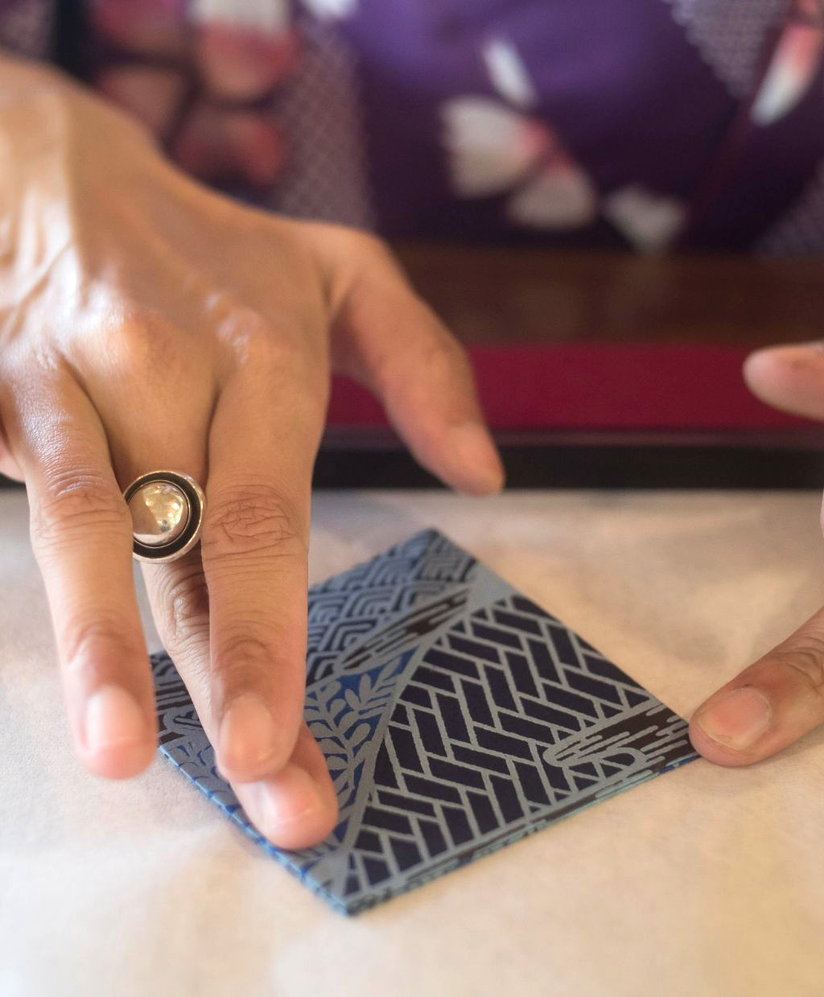
Use some numbers
413,000
8h 50m 4s
Jupiter is the biggest planet of them all
Saturn is a gas giant and has rings

Slide 13
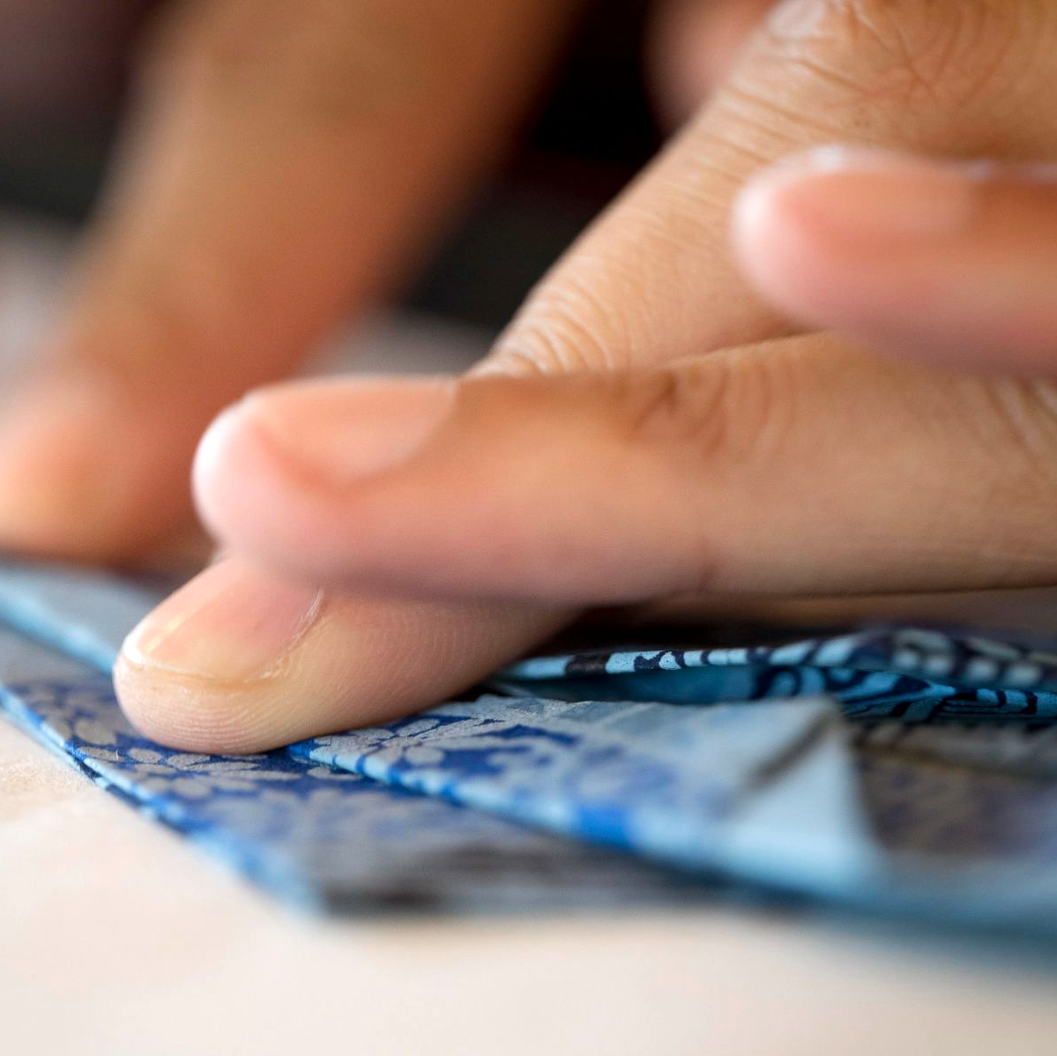
Different techniques
Do you know what helps you make your point clear?
Lists like this one:
They’re simple
You can organize your ideas clearly
You’ll never forget to buy milk!
And the most important thing: the audience won’t miss the point of your presentation

Slide 14
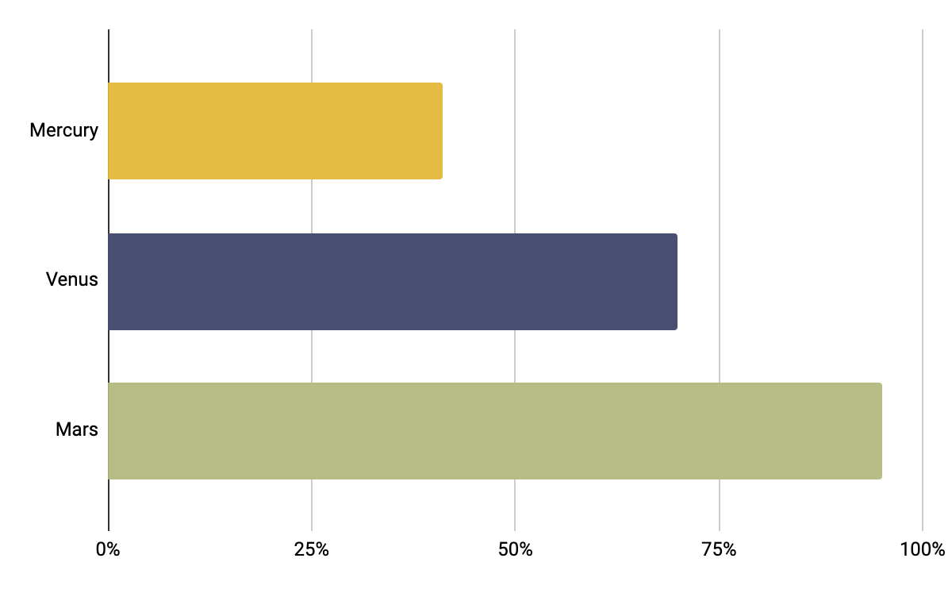
My skills
Mercury – 41%
It’s the closest planet to the Sun
Venus – 70%
Venus is the second planet from the Sun
Mars – 95%
Mars is actually a very cold place
Follow the link in the graph to modify its data and then paste the new one here. For more info, click here

Slide 15
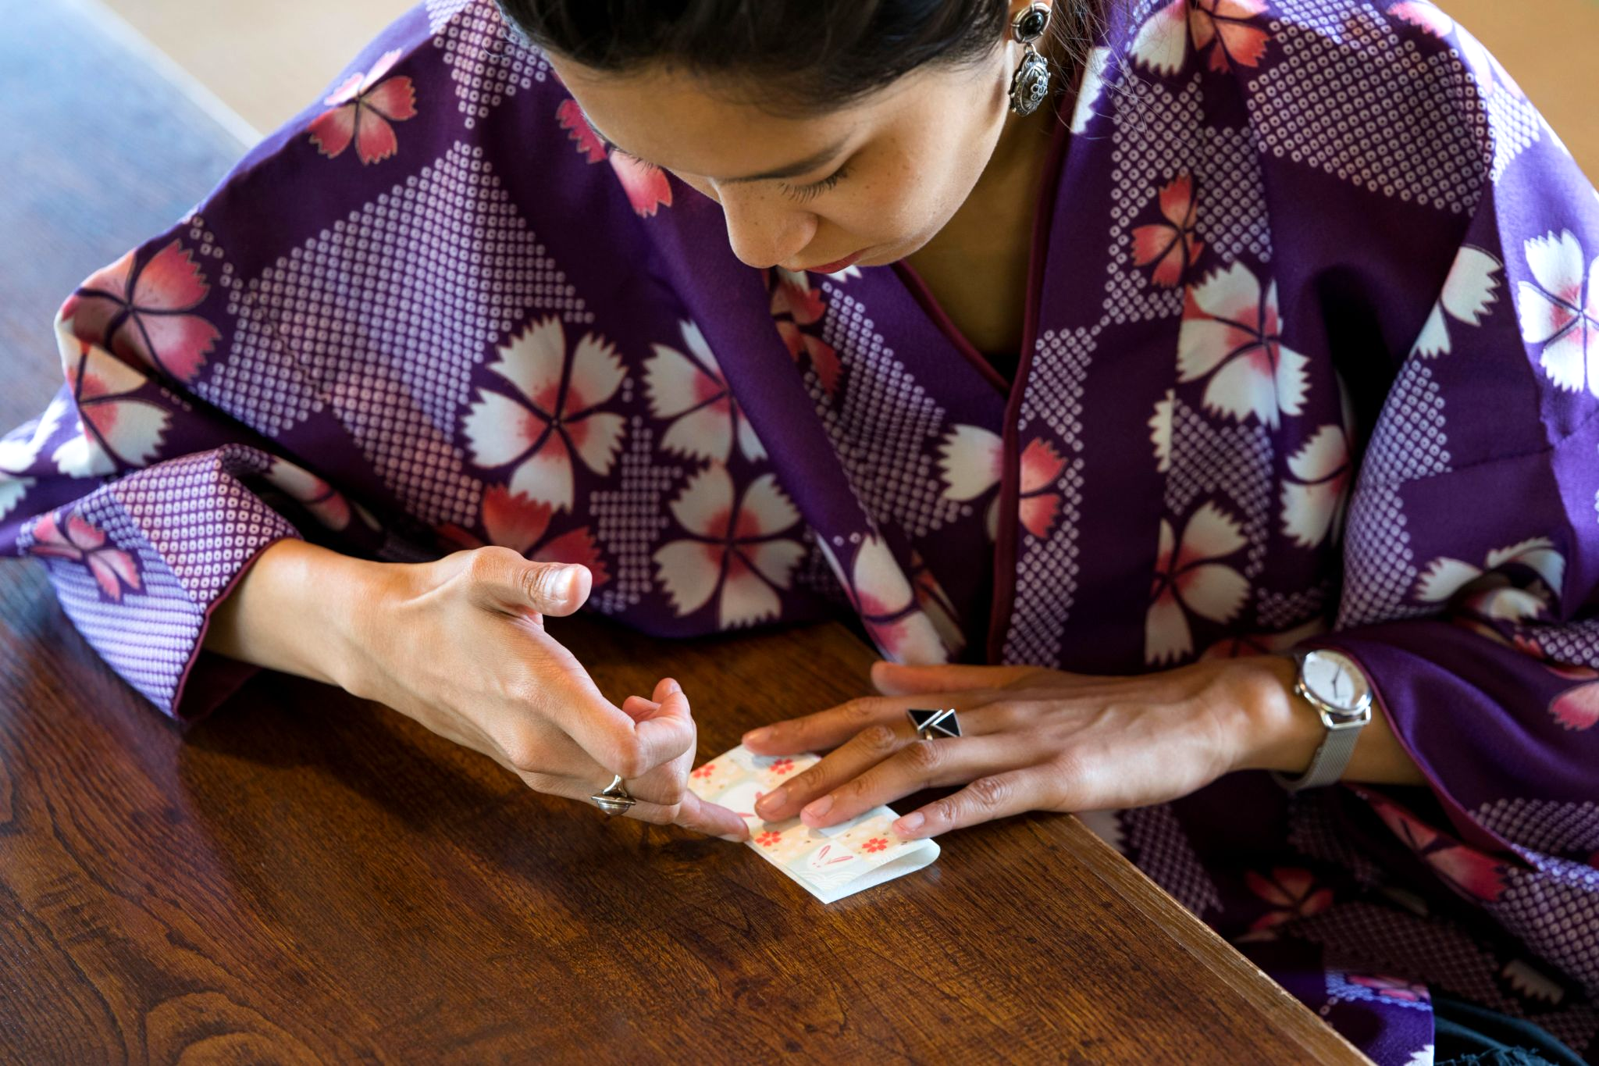
My work
area #1
You can enter a subtitle here if you need it

Slide 16
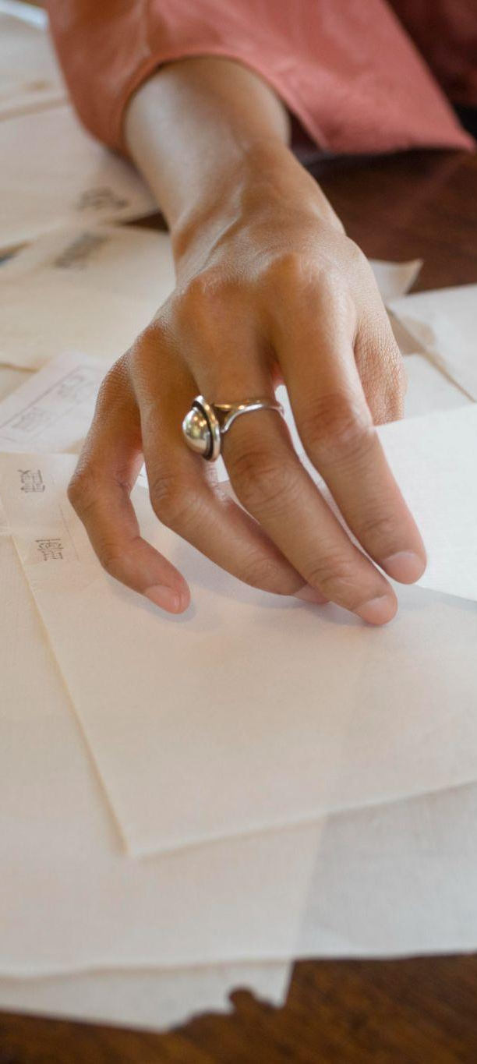
Project 1
Jupiter
Venus
It’s the biggest planet in the Solar System
Venus is the second planet from the Sun
Saturn
Mars
Saturn is a gas giant and has several rings
Despite being red, Mars is a cold place

Slide 17
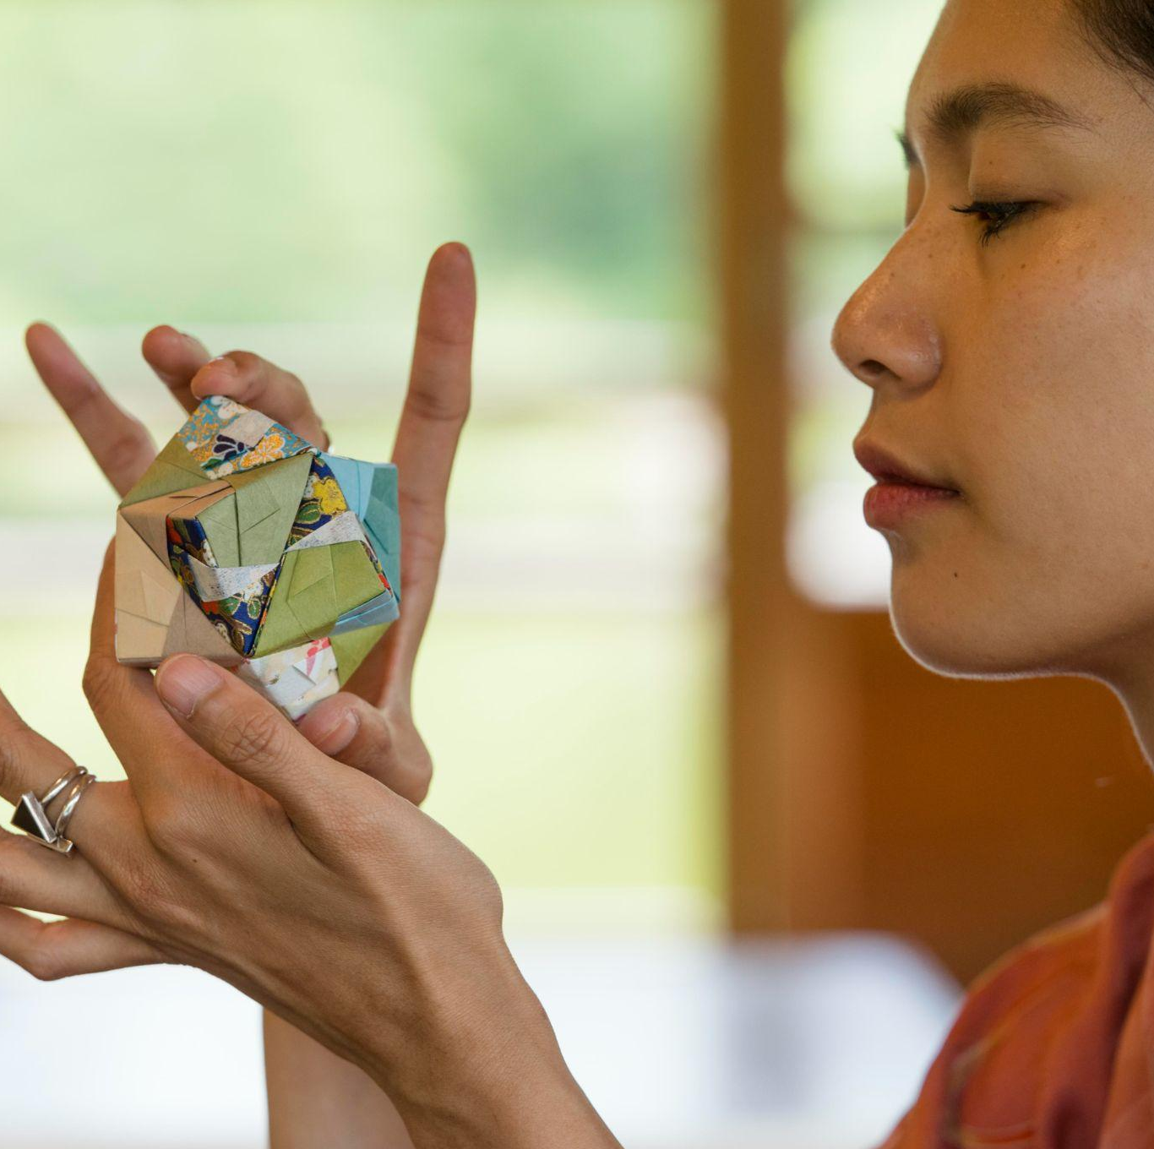
A picture always reinforces
the concept
Images reveal large amounts of data, so remember: use an image instead of a long text. Your audience will appreciate it

Slide 18
Use a table
 | Piece 1 | Piece 2 | Piece 3
Venus |  | Mercury is quite a small planet | Neptune is very far away from Earth
Mars | Venus is the second planet from the Sun |  | Mars is actually a very cold place
Jupiter | Saturn is a gas giant and has rings | Jupiter is the biggest planet of them all

Slide 19
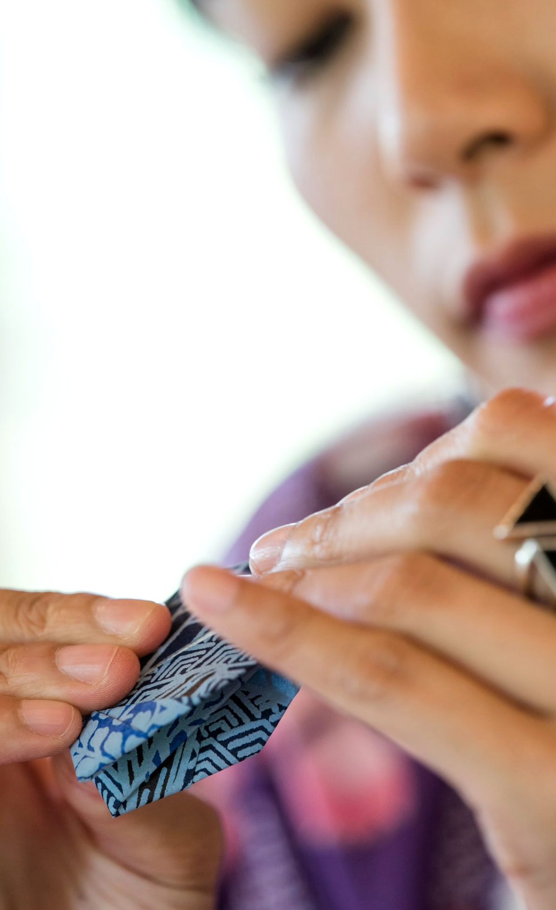
My work
area #2
You can enter a subtitle here if you need it

Slide 20
Project 2
Mercury
Venus
Mars
It’s the closest planet to the Sun
Venus is the second planet from the Sun
Mars is actually a very cold place
Jupiter
Saturn
Neptune
Jupiter is the biggest planet of them all
It’s composed of hydrogen and helium
It’s the farthest planet from the Sun

Slide 21
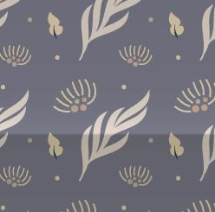
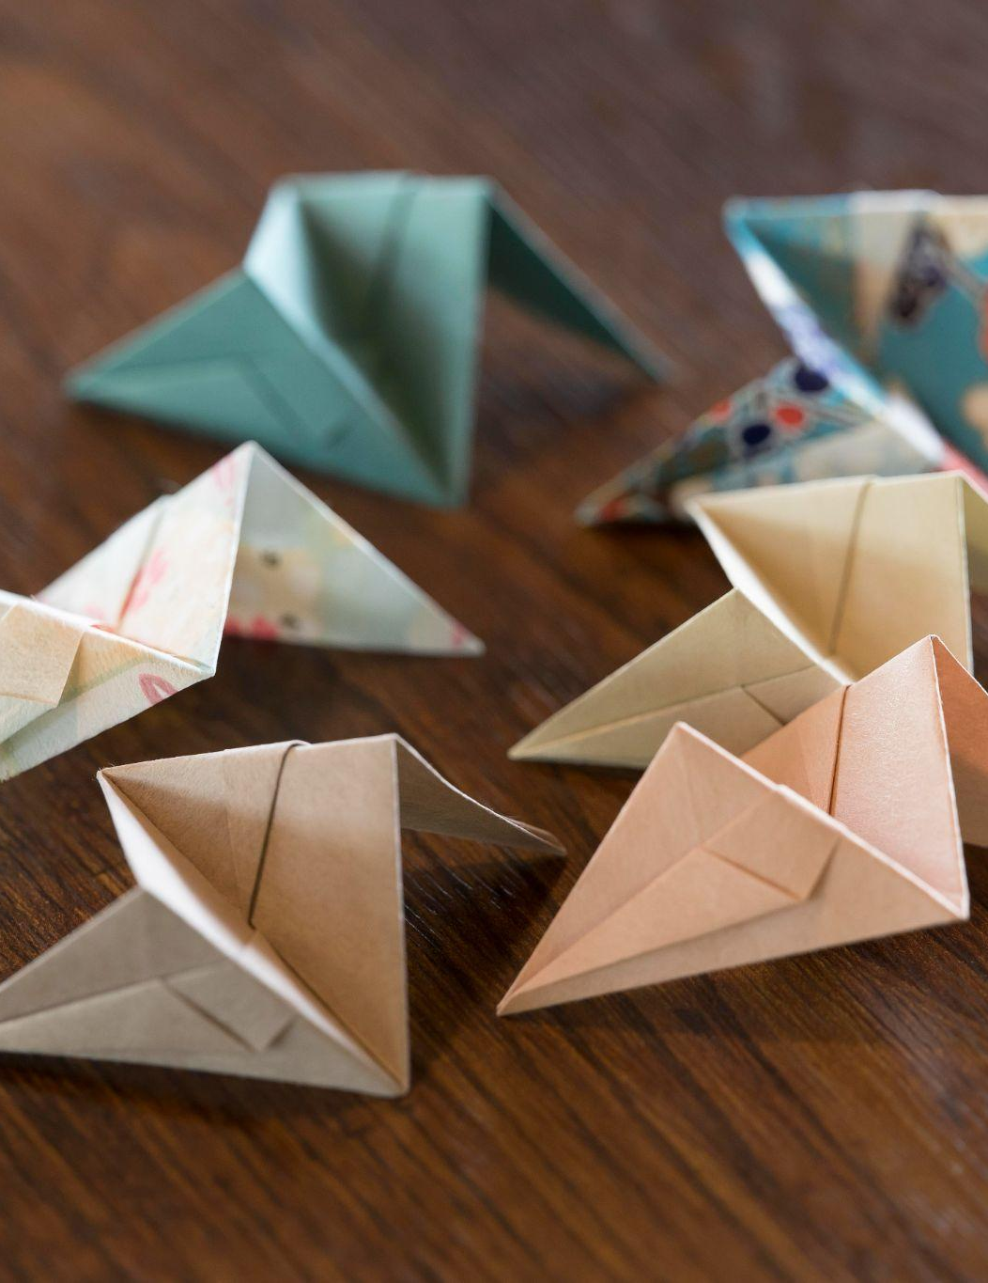
302M
Big numbers catch your audience’s attention

Slide 22
Let me teach you!
Workshop tour
Mercury is quite a small planet

Slide 23
My learning journey
2010
2015
2005
2020
Jupiter
Mars
It’s the biggest planet in the Solar System
Despite being red, Mars is a cold place
Saturn
Venus
Saturn is a gas giant and has several rings
Venus is the second planet from the Sun

Slide 24
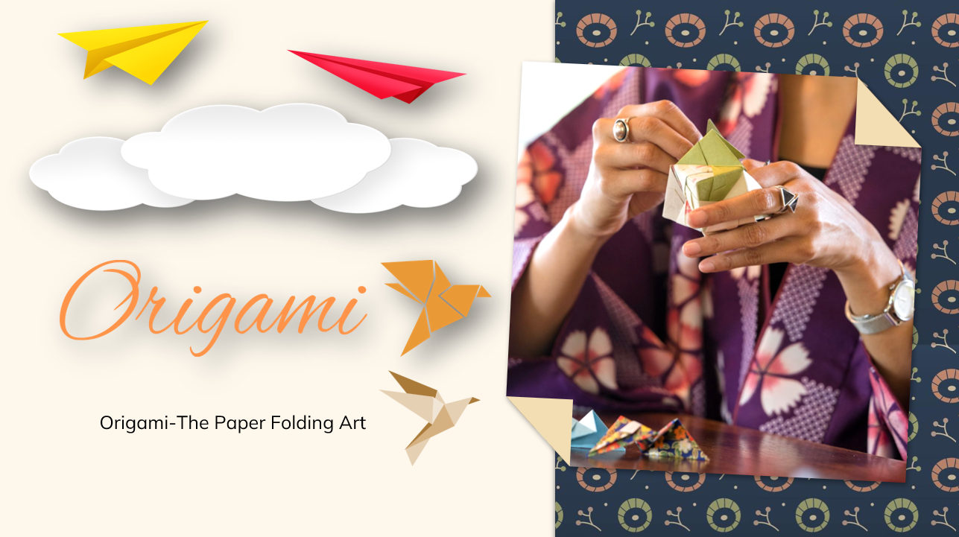
Mockup
You can replace the image on the screen with your own work. Just right-click on it and select “Replace image”

Slide 25
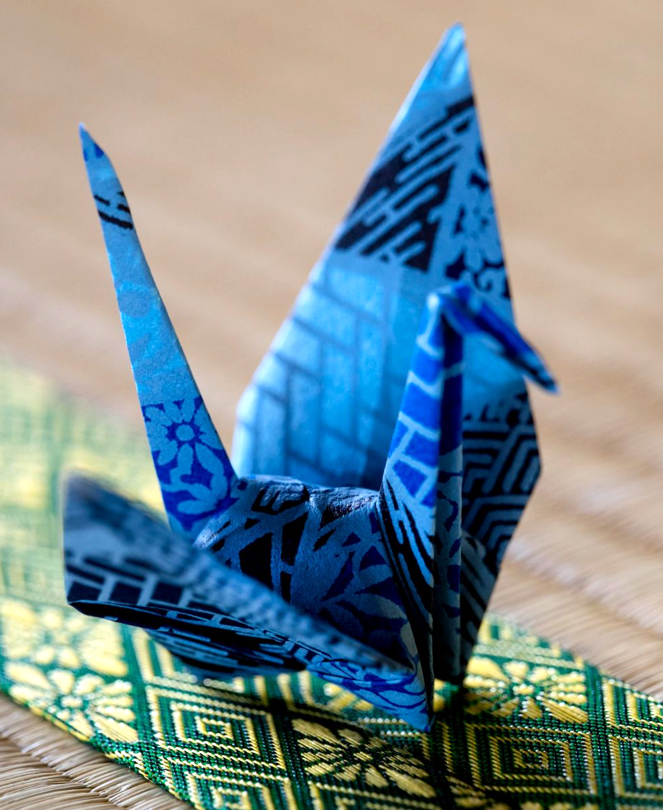
Contact
Do you have any questions?
addyouremail@freepik.com
+91 620 421 838
yourwebsite.com
Please keep this slide as attribution

Slide 26
Icon pack: origami

Slide 27
Alternative resources
Talented woman making origami with japanese paper
High angle small origami boat on world map
Asian woman making origami with japanese paper III
Vectors:
Four flat indigo patterns
Here’s an assortment of alternative resources whose style fits that of this template:
Photos:
Arrangement with origami made object
Close-up of woman hand making creative art craft using origami paper
Woman holding an origami object I
Woman making origami with japanese paper I
Asian woman making origami with japanese paper I
Woman holding an origami object II
Woman holding an origami object III
Woman using special made paper for origami
Woman making origami with japanese paper II
Asian woman making origami with japanese paper II

Slide 28
Resources
Asian woman making origami with japanese paper II
Asian woman making origami with japanese paper III
Woman making origami with japanese paper I
Woman making origami with japanese paper II
Woman making origami with japanese paper III
Woman holding an origami object
Woman using special made paper for origami
Arrangement with origami made object
Woman making origami with japanese paper IV
Woman making origami with japanese paper V
Vectors:
Three oriental patterns
Icons:
Origami | Flat
Did you like the resources of this template? Get them for free at our other websites:
Photos:
Arrangement with origami made object I
Arrangement with origami made object II
Talented woman making origami with japanese paper I
Talented woman making origami with japanese paper II
Talented woman making origami with japanese paper III
Talented woman making origami with japanese paper IV
Asian woman making origami with japanese paper I

